Slide 1
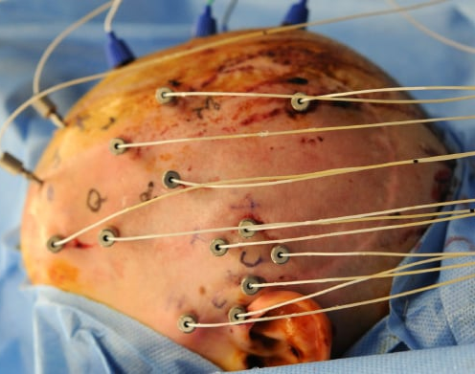
Robot Assisted Deep Brain Implantation ACIT4720
Adam Aske
Faten Alkhair
Yang Solås
Notes:
Hello welcome to our presentation about our project conducted over the last few weeks
First introducing ourselfs:
Adam : My name is Adam, I have a background in simulation technology
Faten :
Yang :

Slide 2
Content
Introduction
Methods
Robot Kinematics
Gyroscope
3D Scanning
3D Printing
Solutions
Conclusion

Slide 3
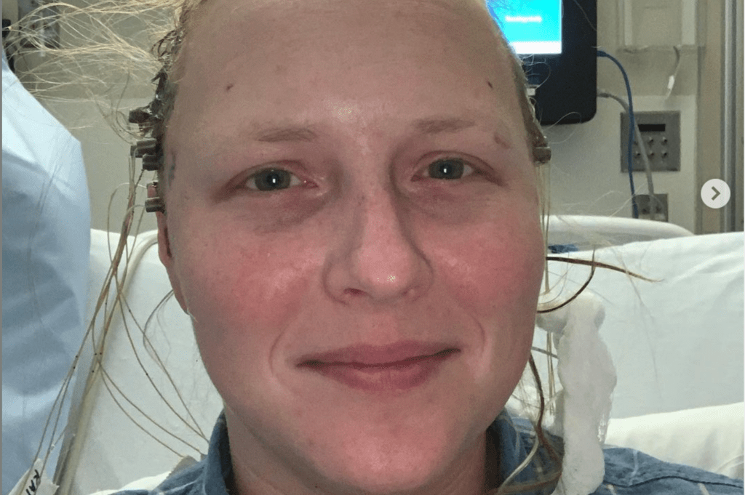
Introduction
Alison
No-warning seziures
Stereo-EEG
Invasive Surgery
Notes:
This is Alison
She started suffering from epilptic seziures when she was 24 years old in 2005.
Ever since she has suffered varying amounts of seziures per year, from 60 per yer to 5 per yer.
During her sizeures she is put at great risk of hurting herself and others.
Topping it off, all the seziures she has expericned has started without any warning.
Due to her sezirues she has both been in a car accident and had seziures alone outside.
Next slide

Slide 4
Brain Implantation
Invasive
Multidisplinary
Notes:
In 2020 she participated in a Stereo-EEG program
She got 8 electrodes implanted into her brain.
These electrodes detects brain-activity, specifically to study the brain activity pre, intra and post epileptic seziures.
After 16 days with these in her head, she learned a lot about her seizures.
From having zero idea about the nature of her seizures, she now knows where her seizures starts inside her brain.
Only 16 days, keep in mind
This knowledge lets the researchers and clinicans learn a lot about her condition and find leads to further treatment.
Additionally, she switched medicine and went 8 months seizure free, her longest streak since the start of her seizures.
She stated afterwards she was greatly inspired and more hopefull about her future than before.
Invasive Brain surgery is a dangerous and complicated type of surgery. Using robot’s has several advatanges such as speed, repeatability and accuracy.

Slide 5
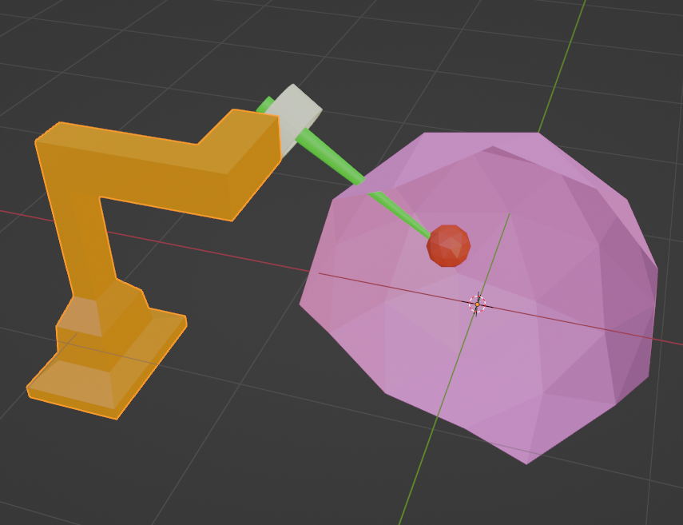
Robot Assisted Deep Brain Implantation
Brain-Robot spatial information
Accuracy
Custom made parts
Notes:
Introducing our project:
We have created a system to assist clinicas do deep-brain implantation surgery
The identified main challenges of this project:
First Brain-Robot spatial information, this means that the system needs to know where the robot is positioned and oriented in relation to the brain / target
Is it 1 meter infront of the robot ? Is it behind and to left ?
Secondly, the robot needs to be accurate. 1-2 millimeter accuracy is nessacry for safety
Thirdly, this requires custom made 3D parts, to replace elements of the robot we’re using.
Next we will cover how we solved these challenges
Next slide

Slide 6
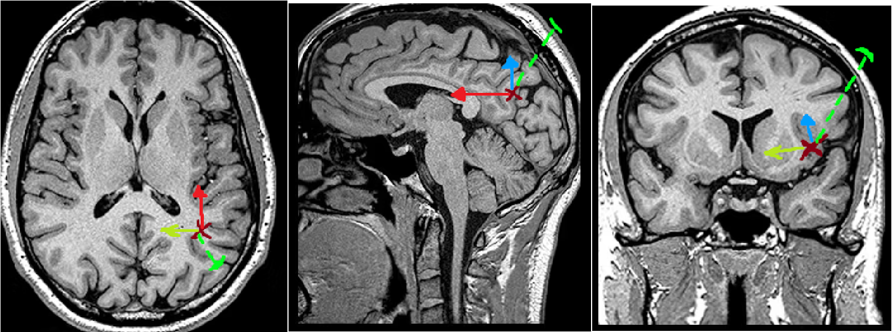
Brain
Target & Entry
Notes:
Limiting the goal of this, this is what we define as a brain surgery.
This is a MRI scan of a brain, and the green line defines a fake safe insertion path.
The start and end of this line we call the target and entry points.
So our goal is to have the robot pose so that its end-effector tool can accomedate brain surgery.

Slide 7
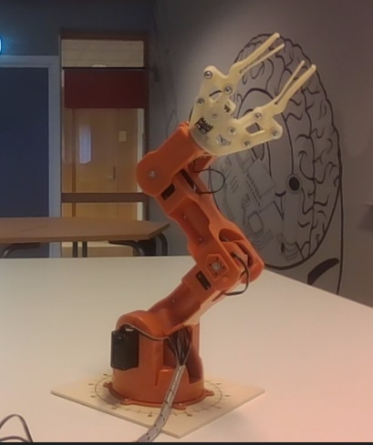
Robots are cool
Kinematics
End-effector
Notes:
This is a Braccio Tinkerkit robotic arm. It is controlled by an arduino
Show in real life

Slide 8

Robot Kinematics
$$R_{x}\left(θ\right)=\left(\begin{matrix}1 & 0 & 0 \\ 0 & cos⁡(θ) & −sin⁡(θ) \\ 0 & sin⁡(θ) & cos⁡(θ)\end{matrix}\right)$$
$$R_{y}\left(θ\right)=\left(\begin{matrix}cos⁡(θ) & 0 & sin⁡(θ) \\ 0 & 1 & 0 \\ −sin⁡(θ) & 0 & cos⁡(θ)\end{matrix}\right)$$
$$R_{z}\left(θ\right)=\left(\begin{matrix}cos⁡(θ) & −sin⁡(θ) & 0 \\ sin⁡(θ) & cos⁡(θ) & 0 \\ 0 & 0 & 1\end{matrix}\right)$$
Forward Kinematics
Inverse Kinematics
Denavitt-Hartenberg model
Notes:
Robot kinematics is the mathematics defining the pose of a robot.
In robot kinematics, each part of the robot is referred to as a link in the robotic chain
At the end of each link, excluding the last link, sits a stepper-motor
Mathematical calculations have been made in order to figure out where the end-effector of the robot is, when the motors are at certain angles..
Forward Kinematics:
Forward kinematics allows us to find the position of the robot’s end-effector, from the angles each link is at.
Starting with defining a common-space for the brain and robot.
This space’s origo as at the base of the robot.
This starts with a rotation matrix and a translation vector
Combing these we get a transformation matrix.
This way the robot can be completely represented as a chain of matrix multiplications.
This is the robot’s FK equation.
-> T EQUATION PICTURE
Inverse Kinematics:
Inverse Kinematics allows us to find the necassery angles of the links, in order for the end-effector to be at a specific location.
The previously found Forward Kinematic contains the information we need for calculating the inverse kinematics.
However, using a math-software which can symbolicly show the equation, grants this
LARGE EQUATION PICTURE
To combat this impossibly difficult equation, we instead model the robot with a Denavitt Hartenberg model
This simplifies some of the calculations by imposing certain rules on the model, however the robot does not obey these rules in “real-life” therefore
Again this is made into matrices and the final equation is a chain of matrix multiplication
This gives an easier equation to work with inorder to calculate the DH - Inverse Kinematics

Slide 9

Robot Kinematics
Forward Kinematics
Inverse Kinematics
Denavitt-Hartenberg model
$$T_{0}=\left[\begin{matrix}Z_{θ_{1}} & P_{1} \\ 0 & 1\end{matrix}\right]=\left[\begin{matrix}Z_{11θ_{1}} & Z_{12θ_{1}} & Z_{13θ_{1}} & p_{1} \\ Z_{21θ_{1}} & Z_{22θ_{1}} & Z_{23θ_{1}} & 0 \\ Z_{31θ_{1}} & Z_{32θ_{1}} & Z_{33θ_{1}} & d_{1} \\ 0 & 0 & 0 & 1\end{matrix}\right]$$
$$T=T_{0}T_{1}T_{2}T_{3}T_{4}=\left[\begin{matrix}Z_{θ_{1}} & P_{1} \\ 0 & 1\end{matrix}\right]\left[\begin{matrix}Z_{θ_{2}} & P_{2} \\ 0 & 1\end{matrix}\right]\left[\begin{matrix}Z_{θ_{3}} & P_{3} \\ 0 & 1\end{matrix}\right]\left[\begin{matrix}Z_{θ_{4}} & P_{4} \\ 0 & 1\end{matrix}\right]\left[\begin{matrix}Z_{θ_{5}} & P_{5} \\ 0 & 1\end{matrix}\right]$$
Notes:
We started with this robot, the TINKERKTI BRACCIO
Hopefully you all can excuse the techincal rant about to begin
Robot kinematics is the mathematics defining the pose of a robot.
In robot kinematics, each part of the robot is referred to as a link in the robotic chain
At the end of each link, excluding the last link, sits a stepper-motor
Mathematical calculations have been made in order to figure out where the end-effector of the robot is, when the motors are at certain angles..
Forward Kinematics:
Forward kinematics allows us to find the position of the robot’s end-effector, from the angles each link is at.
Starting with defining a common-space for the brain and robot.
This space’s origo as at the base of the robot.
This starts with a rotation matrix and a translation vector
Combing these we get a transformation matrix.
This way the robot can be completely represented as a chain of matrix multiplications.
This is the robot’s FK equation.
-> T EQUATION PICTURE
Inverse Kinematics:
Inverse Kinematics allows us to find the necassery angles of the links, in order for the end-effector to be at a specific location.
The previously found Forward Kinematic contains the information we need for calculating the inverse kinematics.
However, using a math-software which can symbolicly show the equation, grants this
LARGE EQUATION PICTURE
To combat this impossibly difficult equation, we instead model the robot with a Denavitt Hartenberg model
This simplifies some of the calculations by imposing certain rules on the model, however the robot does not obey these rules in “real-life” therefore
Again this is made into matrices and the final equation is a chain of matrix multiplication
This gives an easier equation to work with inorder to calculate the DH - Inverse Kinematics

Slide 10
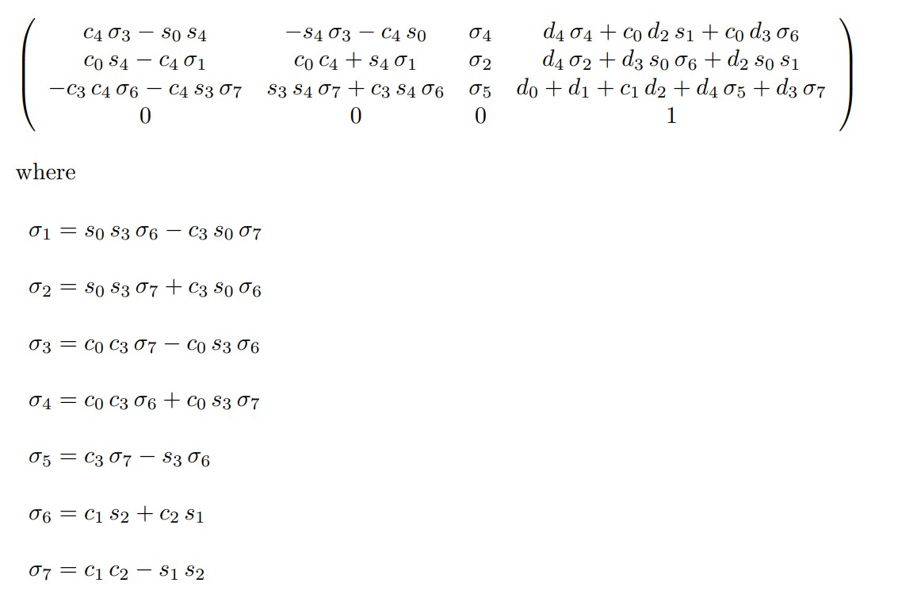
Robot Kinematics
Forward Kinematics
Inverse Kinematics
Denavitt-Hartenberg model
Notes:
We started with this robot, the TINKERKTI BRACCIO
Hopefully you all can excuse the techincal rant about to begin
Robot kinematics is the mathematics defining the pose of a robot.
In robot kinematics, each part of the robot is referred to as a link in the robotic chain
At the end of each link, excluding the last link, sits a stepper-motor
Mathematical calculations have been made in order to figure out where the end-effector of the robot is, when the motors are at certain angles..
Forward Kinematics:
Forward kinematics allows us to find the position of the robot’s end-effector, from the angles each link is at.
Starting with defining a common-space for the brain and robot.
This space’s origo as at the base of the robot.
This starts with a rotation matrix and a translation vector
Combing these we get a transformation matrix.
This way the robot can be completely represented as a chain of matrix multiplications.
This is the robot’s FK equation.
-> T EQUATION PICTURE
Inverse Kinematics:
Inverse Kinematics allows us to find the necassery angles of the links, in order for the end-effector to be at a specific location.
The previously found Forward Kinematic contains the information we need for calculating the inverse kinematics.
However, using a math-software which can symbolicly show the equation, grants this
LARGE EQUATION PICTURE
This is an extremely difficult equation to solve, therefore simplification is needed.
Next slide
To combat this impossibly difficult equation, we instead model the robot with a Denavitt Hartenberg model
This simplifies some of the calculations by imposing certain rules on the model, however the robot does not obey these rules in “real-life” therefore
Again this is made into matrices and the final equation is a chain of matrix multiplication
This gives an easier equation to work with inorder to calculate the DH - Inverse Kinematics

Slide 11
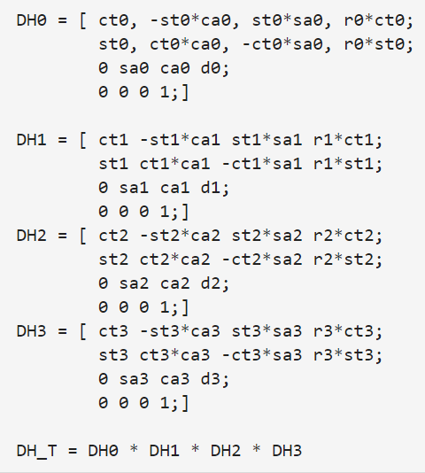
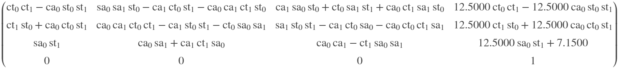
Robot Kinematics
Forward Kinematics
Inverse Kinematics
Denavitt-Hartenberg model
Notes:
We started with this robot, the TINKERKTI BRACCIO
Hopefully you all can excuse the techincal rant about to begin
Robot kinematics is the mathematics defining the pose of a robot.
In robot kinematics, each part of the robot is referred to as a link in the robotic chain
At the end of each link, excluding the last link, sits a stepper-motor
Mathematical calculations have been made in order to figure out where the end-effector of the robot is, when the motors are at certain angles..
Forward Kinematics:
Forward kinematics allows us to find the position of the robot’s end-effector, from the angles each link is at.
Starting with defining a common-space for the brain and robot.
This space’s origo as at the base of the robot.
This starts with a rotation matrix and a translation vector
Combing these we get a transformation matrix.
This way the robot can be completely represented as a chain of matrix multiplications.
This is the robot’s FK equation.
-> T EQUATION PICTURE
Inverse Kinematics:
Inverse Kinematics allows us to find the necassery angles of the links, in order for the end-effector to be at a specific location.
The previously found Forward Kinematic contains the information we need for calculating the inverse kinematics.
However, using a math-software which can symbolicly show the equation, grants this
LARGE EQUATION PICTURE
To combat this impossibly difficult equation, we instead model the robot with a Denavitt Hartenberg model
This simplifies some of the calculations by imposing certain rules on the model, however the robot does not obey these rules in “real-life” therefore
Again this is made into matrices and the final equation is a chain of matrix multiplication
This gives an easier equation to work with inorder to calculate the DH - Inverse Kinematics
Now to the application of these maths
Next slide

Slide 12
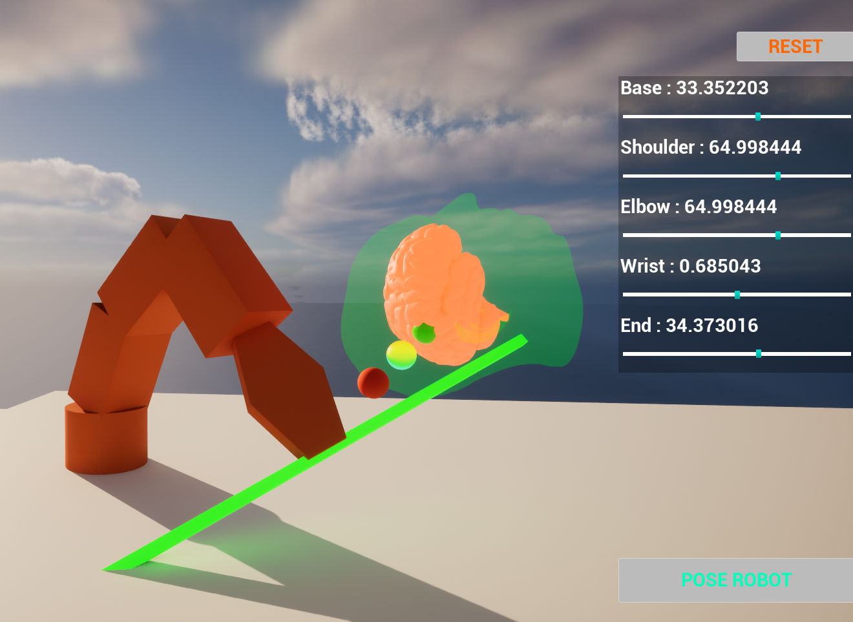
Notes:
In order to make this calculations and work with the robot, we made a simulation in Unreal Engine.
This allows for fast iteration times, specifically due to the robot and its interface
The math I went over previously is all coded into this
The robot always starts with a jerk motion
Needs to be reset each time
No numerical feedback
This is a screenshot of the simulation.
The orange part is a visual for the robot and its accuratly dimensioned to the BRACCIO robot
The sliders on the right side determines the angle of each of the joints.
Also is the brain and head visualized.
The green ball is the target point «inside» the brain. And the red ball is the «Entry target».
Meaning that if the green line is intercepting both the red and green ball, its a success.
Altough the visualization is nice, the point is working with the data which controls the system which is not displayed here.
SLIDE

Slide 13
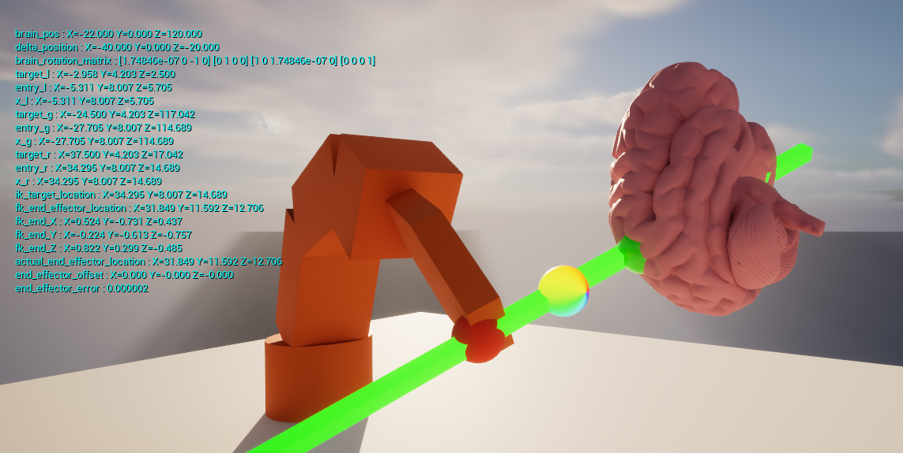




Notes:
Just to quickly show it
Here severall of the important factors in the calculation is displayed.
This incluldes both «regular» FK and IK, aswell as DH FK and IK
The highlited…

Slide 14
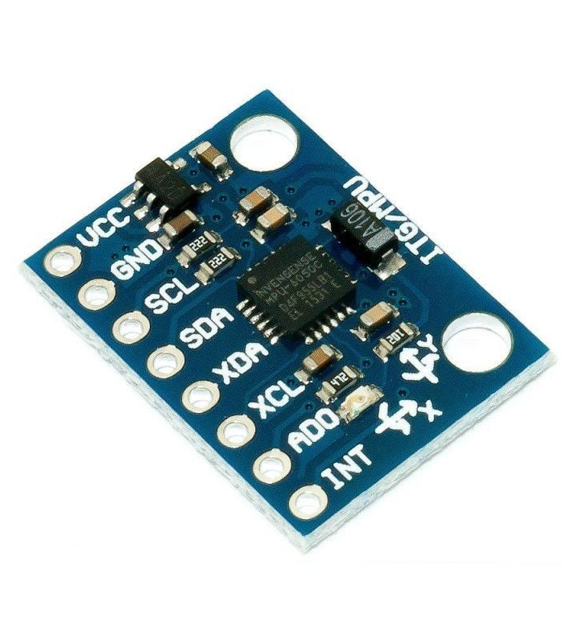
Sensory elements
Gyroscope - MPU-6050
Calibration - accuracy
Potential errors
Low precision requirement
Cost-effective
Notes:
Custom C code
Calibrate function - > Once the robot is at its rest position

Slide 15
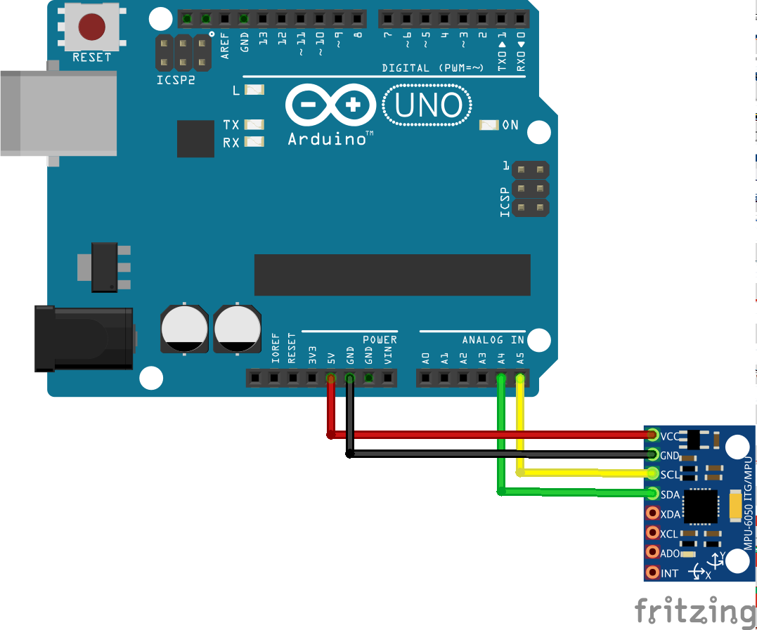
Sensory elements
I2C - Inter-Integrated Circuit
Two wires

Slide 16
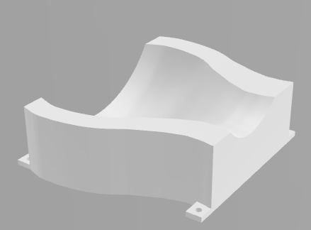
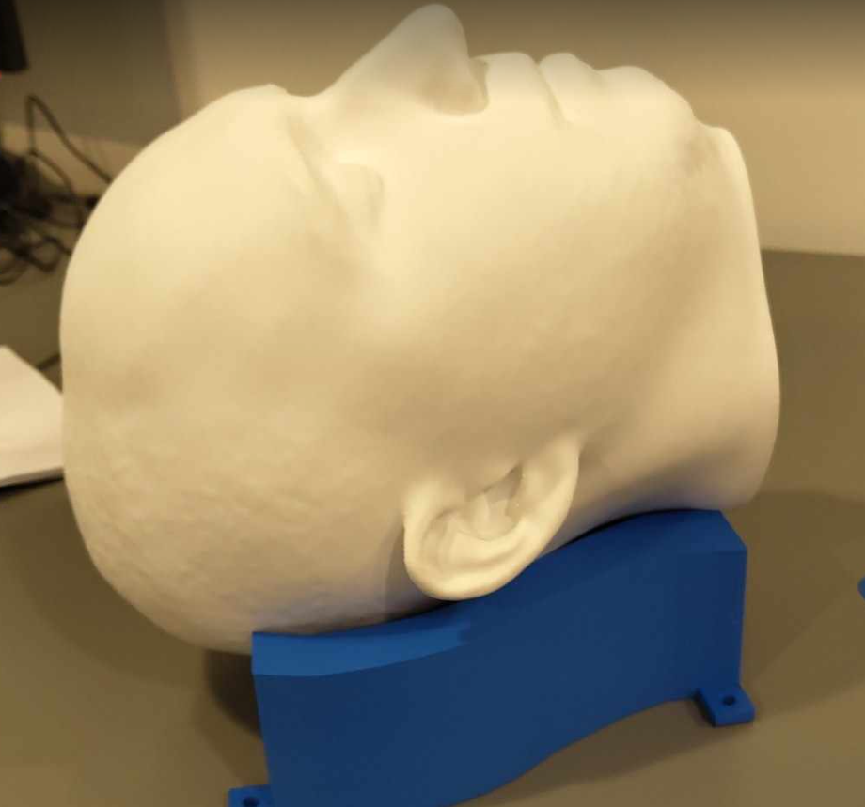
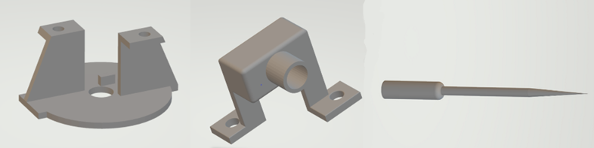
3D Scanning and Printing
Head Scan
Head 3D print with brain inside
New custom end-effector
Notes:
Head scan -> Adam scan because he’s bald, hair makes it more difficult
A stand which is suitable to the head was designed and 3D printed. The stand will determine the position of the head and the brain in the robotic coordinate system.
The end-effector had been suitable with the robotic arm, light, simple and easy to assemble and disassemble.
the tool should be interchangeable to suit the requirements of the surgery

Slide 17
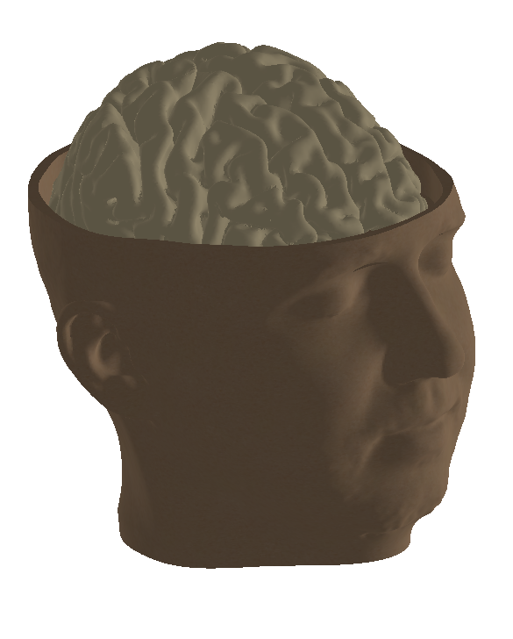
3D printed brain
Allow doctors to plan a practice procedure before the patient goes under the knife
Notes:
We wished we could get an MRI scan of the brain to get 3d model of the brain,
by printing a lifelike human brain from uniquely silicone-based inks. These specially designed inks mimic the tissue properties and the mechanics of a real brain,
Furthermore it could be fitted sensors into these 3D printed organs, that allows the doctors to collect data on how the brain is going to behave when it underwent tests and is poked or prodded by various surgical tools.
There is a research about 3d printed prostate,
It was discovered that the printed organs were replicating the properties of a real human organ to a high degree of accuracy.

Slide 18
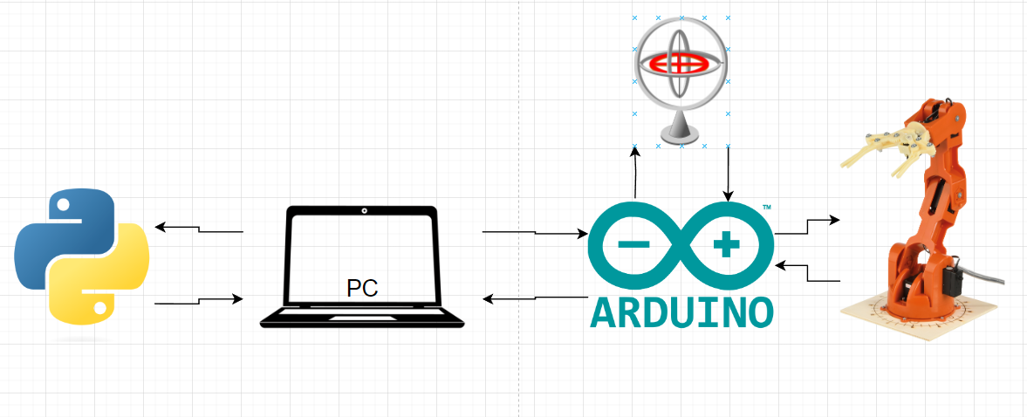
Overview
Notes:
This is the overview of the system in actino
The computer is communicating with the arduino across the serial port
A custom python script is running on the computer and is communicating with the Arduino over the serial port.
Meanwhile, the simulation is running.
The gyroscope sends information
The final process to use the developed system is defined by 7 steps:
Connect computer to Arduino via USB.
Launch the simulation.
Launch Python program.
Interface with the program to choose target and entry points.
Pose the robot accordingly inside the simulation.
Press the “Pose”-button.
Wait a few seconds and watch the robot pose itself correctly.

Slide 19
Demonstration
☺

Slide 20
Conclusion
Ask neurosurgeons.
Real-time head-tracking.
Notes:
Learned about robot kinematics
This is all been implemented without any feedback or research into what neurosurgons doint this kind of surgeries actually wants or needs.
This would be the overall most important step to improve the system furhter.
Saftey is an important issue with this kind of system,
Further oppurtinutes:
Real-time spatial tracking of the head is crucial for real deployment, real deployments of this often uses a combination of technieques to find the heads positon in relation the robot
The accelerometer is running, but not used, this can be added to get a second measure of position.
The 3D scanning of the head is currently not involved

